Slide 1
노드 삽입
(Insert Node)

Slide 2
Root(Always search starts from the root)
Insert Node
22
9
67
3
14
36
94
1
7
44
97

Slide 3
Root
Insert Node
22
9
67
Let’s Insert 34
3
14
36
94
1
7
44
97

Slide 4

Root
Insert Node
9
67
Let’s Insert 34
3
14
36
94
1
7
44
97

Slide 5
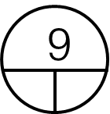
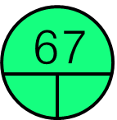
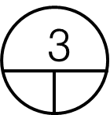



Root
Insert Node
Let’s Insert 34
36
94
44
97

Slide 6
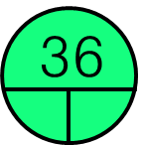
Root
Insert Node
Let’s Insert 34
94
44
97

Slide 7
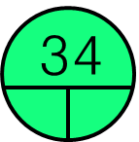
Root
Insert Node
Let’s Insert 34
94
44
97

Slide 8
Root
Insert Node
Let’s Insert 34
94
44
97

Slide 9
노드 삭제(Delete Node)
A leaf node(자식이 없을 때)

Slide 10
Root(Always search starts from the root)
Delete a Leaf Node.
22
9
67
3
14
36
94
1
7
44
97

Slide 11
Root
Delete a Leaf Node.
22
9
67
Let’s Delete 14
3
14
36
94
1
7
44
97

Slide 12
Root
Delete a Leaf Node.
9
67
Let’s Delete 14
3
14
36
94
1
7
44
97

Slide 13
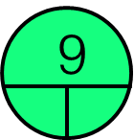
Root
Delete a Leaf Node.
67
Let’s Delete 14
36
94
44
97

Slide 14
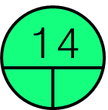
Root
Delete a Leaf Node.
67
Let’s Delete 14
36
94
44
97

Slide 15
Root
Delete a Leaf Node.
67
Let’s Delete 14
36
94
44
97

Slide 16
Root
Delete a Leaf Node.
67
Let’s Delete 14
36
94
44
97

Slide 17
Root(Always search starts from the root)
Delete a Leaf Node.
22
9
67
3
14
36
94
1
7
44
97

Slide 18
Root
Delete a Leaf Node.
22
9
67
Let’s Delete 44
3
14
36
94
1
7
44
97

Slide 19
Root
Delete a Leaf Node.
9
67
Let’s Delete 44
3
14
36
94
1
7
44
97

Slide 20
Root
Delete a Leaf Node.
Let’s Delete 44
36
94
44
97

Slide 21
Root
Delete a Leaf Node.
Let’s Delete 44
94
44
97

Slide 22
Root
Delete a Leaf Node.
Let’s Delete 44
94
44
97

Slide 23
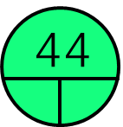
Root
Delete a Leaf Node.
Let’s Delete 44
94
97

Slide 24
Root
Delete a Leaf Node.
Let’s Delete 44
94
97

Slide 25
노드 삭제(Delete Node)
One child(자식이 하나일 때)

Slide 26
Root(Always search starts from the root)
Determine if it has a left or a right child.
One child → delete and change the pointer to this child
22
9
67
3
14
36
94
1
7
44
97

Slide 27
Root(Always search starts from the root)
Determine if it has a left or a right child.
One child → delete and change the pointer to this child
22
Let’s Delete 36
9
67
3
14
36
94
1
7
44
97

Slide 28
Root(Always search starts from the root)
Determine if it has a left or a right child.
One child → delete and change the pointer to this child
Let’s Delete 36
9
67
3
14
36
94
1
7
44
97

Slide 29
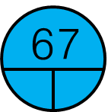
Root(Always search starts from the root)
Determine if it has a left or a right child.
One child → delete and change the pointer to this child
Let’s Delete 36
9
3
14
36
94
1
7
44
97

Slide 30
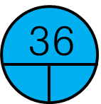
Root(Always search starts from the root)
Determine if it has a left or a right child.
One child → delete and change the pointer to this child
Let’s Delete 36
9
3
14
94
1
7
44
97

Slide 31
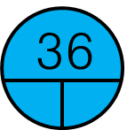
Root(Always search starts from the root)
Determine if it has a left or a right child.
One child → delete and change the pointer to this child
Let’s Delete 36
9
3
14
94
1
7
44
97

Slide 32

Root(Always search starts from the root)
Determine if it has a left or a right child.
One child → delete and change the pointer to this child
Let’s Delete 36
9
3
14
94
1
7
97

Slide 33

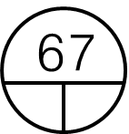
Root(Always search starts from the root)
Determine if it has a left or a right child.
One child → delete and change the pointer to this child
The final resulting tree –
still has search structure.
9
3
14
94
1
7
97

Slide 34
Root(Always search starts from the root)
Determine if it has a left or a right child.
One child → delete and change the pointer to this child
22
9
67
3
14
36
94
1
7
44
97

Slide 35
Root(Always search starts from the root)
Determine if it has a left or a right child.
One child → delete and change the pointer to this child
22
Let’s Delete 94
9
67
3
14
36
94
1
7
44
97

Slide 36
Root(Always search starts from the root)
Determine if it has a left or a right child.
One child → delete and change the pointer to this child
Let’s Delete 94
9
67
3
14
36
94
1
7
44
97

Slide 37
Root(Always search starts from the root)
Determine if it has a left or a right child.
One child → delete and change the pointer to this child
Let’s Delete 94
9
3
14
36
94
1
7
44
97

Slide 38

Root(Always search starts from the root)
Determine if it has a left or a right child.
One child → delete and change the pointer to this child
Let’s Delete 94
9
3
14
36
1
7
44
97

Slide 39
Root(Always search starts from the root)
Determine if it has a left or a right child.
One child → delete and change the pointer to this child
Let’s Delete 94
9
3
14
36
1
7
44
97

Slide 40

Root(Always search starts from the root)
Determine if it has a left or a right child.
One child → delete and change the pointer to this child
Let’s Delete 94
9
3
14
36
1
7
44

Slide 41
Root(Always search starts from the root)
Determine if it has a left or a right child.
One child → delete and change the pointer to this child
The final resulting tree –
still has search structure.
9
3
14
36
1
7
44

Slide 42
노드 삭제(Delete Node)
Two child(자식이 2개일 때)

Slide 43
Root(Always search starts from the root)
Node to be removed has two children.
We must choose the two ways.
Case1. Largest from left sub-tree
Case2. Smallest from right sub-tree
22
9
67
3
14
36
94
1
7
44
97

Slide 44
Root
Node to be removed has two children.
We must choose the two ways.
Case1. Largest from left sub-tree
Case2. Smallest from right sub-tree
22
9
67
Let’s Delete 22
3
14
36
94
1
7
44
97

Slide 45
Root
Node to be removed has two children.
We must choose the two ways.
Case1. Largest from left sub-tree
Case2. Smallest from right sub-tree
9
67
3
14
36
94
1
7
44
97

Slide 46
Root
Node to be removed has two children.
We must choose the two ways.
Case1. Largest from left sub-tree
Case2. Smallest from right sub-tree
67
36
94
44
97

Slide 47
Root
Node to be removed has two children.
We must choose the two ways.
Case1. Largest from left sub-tree
Case2. Smallest from right sub-tree
67
Find and copy the largest value in the left sub-tree.
36
94
44
97

Slide 48
Root
Node to be removed has two children.
We must choose the two ways.
Case1. Largest from left sub-tree
Case2. Smallest from right sub-tree
67
Find and copy the largest value in the left sub-tree.
In current example it is 14.
36
94
44
97

Slide 49
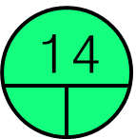
Root
Node to be removed has two children.
We must choose the two ways.
Case1. Largest from left sub-tree
Case2. Smallest from right sub-tree
67
Replace 22 with 14.
36
94
44
97

Slide 50

Root
Node to be removed has two children.
We must choose the two ways.
Case1. Largest from left sub-tree
Case2. Smallest from right sub-tree
67
Now delete the duplicate(14) from the left sub-tree.
36
94
44
97

Slide 51
Root
Node to be removed has two children.
We must choose the two ways.
Case1. Largest from left sub-tree
Case2. Smallest from right sub-tree
67
Now delete the duplicate(14) from the left sub-tree.
36
94
44
97

Slide 52
Root
Node to be removed has two children.
We must choose the two ways.
Case1. Largest from left sub-tree
Case2. Smallest from right sub-tree
67
Now delete the duplicate(14) from the left sub-tree.
36
94
44
97

Slide 53

Root
Node to be removed has two children.
We must choose the two ways.
Case1. Largest from left sub-tree
Case2. Smallest from right sub-tree
67
The final resulting tree –
still has search structure.
36
94
44
97

Slide 54
Root(Always search starts from the root)
Node to be removed has two children.
We must choose the two ways.
Case1. Largest from left sub-tree
Case2. Smallest from right sub-tree
22
9
67
3
14
36
94
1
7
44
97

Slide 55
Root
Node to be removed has two children.
We must choose the two ways.
Case1. Largest from left sub-tree
Case2. Smallest from right sub-tree
22
9
67
Let’s Delete 22
3
14
36
94
1
7
44
97

Slide 56
Root
Node to be removed has two children.
We must choose the two ways.
Case1. Largest from left sub-tree
Case2. Smallest from right sub-tree
9
67
3
14
36
94
1
7
44
97

Slide 57
Root
Node to be removed has two children.
We must choose the two ways.
Case1. Largest from left sub-tree
Case2. Smallest from right sub-tree
36
94
44
97

Slide 58
Root
Node to be removed has two children.
We must choose the two ways.
Case1. Largest from left sub-tree
Case2. Smallest from right sub-tree
Find and copy the smallest value in the right sub-tree.
94
44
97

Slide 59
Root
Node to be removed has two children.
We must choose the two ways.
Case1. Largest from left sub-tree
Case2. Smallest from right sub-tree
Find and copy the smallest value in the right sub-tree.
In current example it is 36.
94
44
97

Slide 60

Root
Node to be removed has two children.
We must choose the two ways.
Case1. Largest from left sub-tree
Case2. Smallest from right sub-tree
Replace 22 with 36.
94
44
97

Slide 61
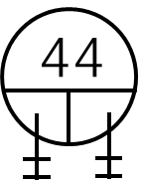
Root
Node to be removed has two children.
We must choose the two ways.
Case1. Largest from left sub-tree
Case2. Smallest from right sub-tree
Now delete the duplicate(36) from the right sub-tree.
94
97

Slide 62
Root
Node to be removed has two children.
We must choose the two ways.
Case1. Largest from left sub-tree
Case2. Smallest from right sub-tree
Now delete the duplicate(36) from the right sub-tree.
94
97

Slide 63
Root
Node to be removed has two children.
We must choose the two ways.
Case1. Largest from left sub-tree
Case2. Smallest from right sub-tree
Move the pointer.
94
97

Slide 64
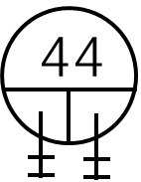
Root
Node to be removed has two children.
We must choose the two ways.
Case1. Largest from left sub-tree
Case2. Smallest from right sub-tree
Move the pointer.
94
97

Slide 65
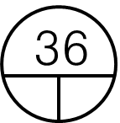
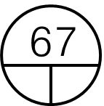

Root
Node to be removed has two children.
We must choose the two ways.
Case1. Largest from left sub-tree
Case2. Smallest from right sub-tree
The final resulting tree –
still has search structure.
94
97

